Slide 1


Slide 2
version control
What is Version Control?
A system that records changes to a file or set of files.
You can do this with any kind of file on a computer, for our purposes we will focus on software source code, which is the primary use case (Source control).
Keeps a log of changes over time
You can recall specific versions of the source code at later times.
Why do you need version control?
Enables easy collaboration on source files between team members
Provides a very handy log of work done over time.
Allows you to easily track down when bugs were introduced and by whom.
If you mess things up or lose files, you can easily recover them.
Helps you to stop just copying the files into many directories. You know you’ve done it.

Slide 3
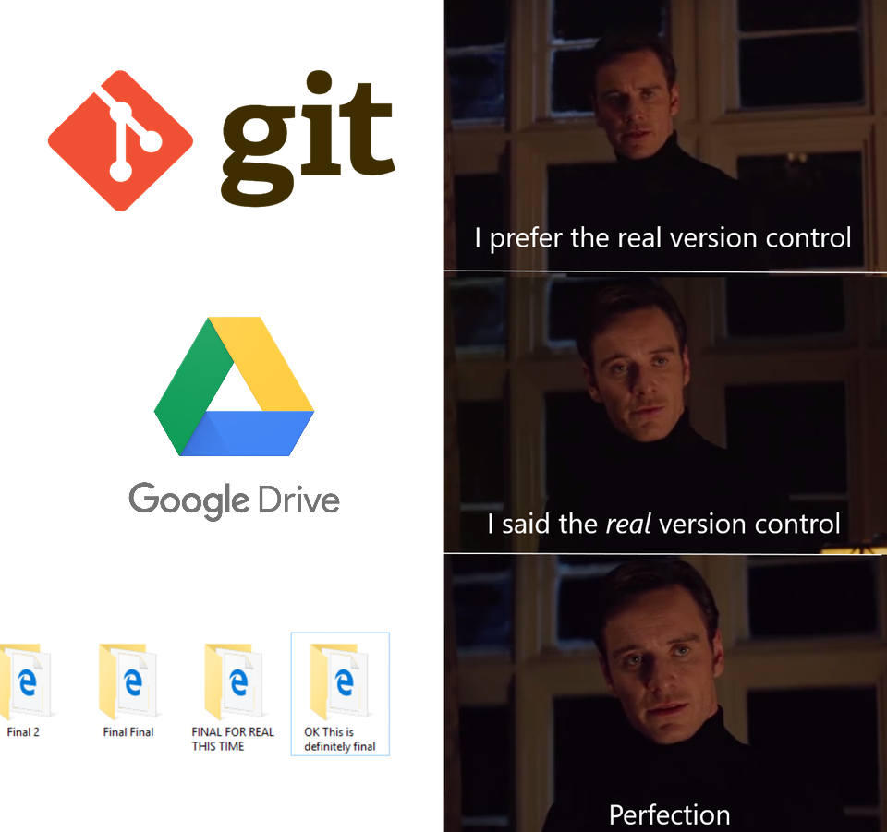

Slide 4
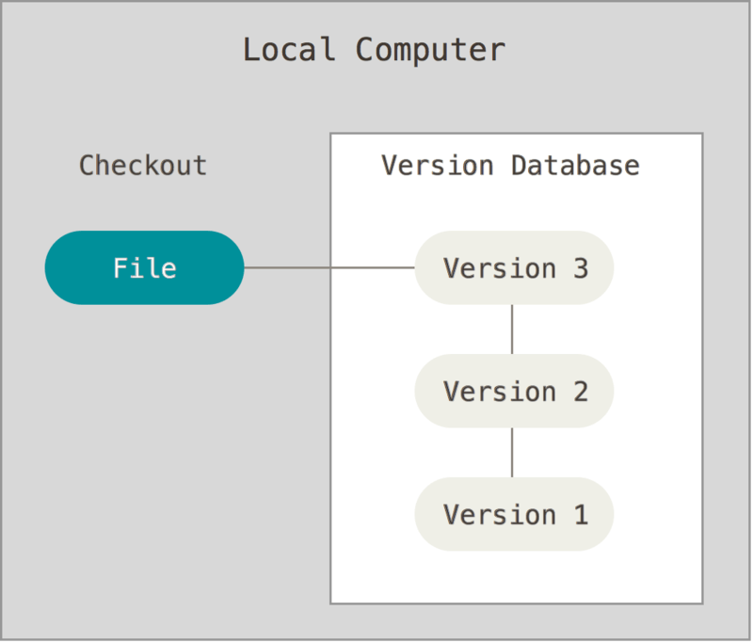
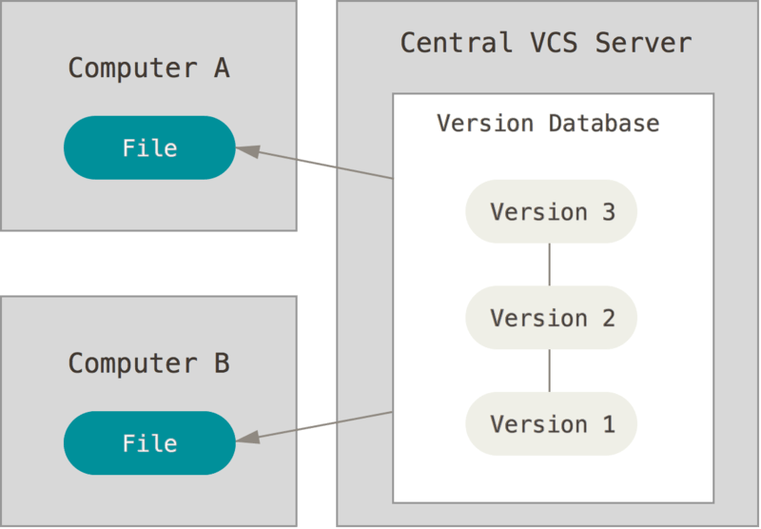
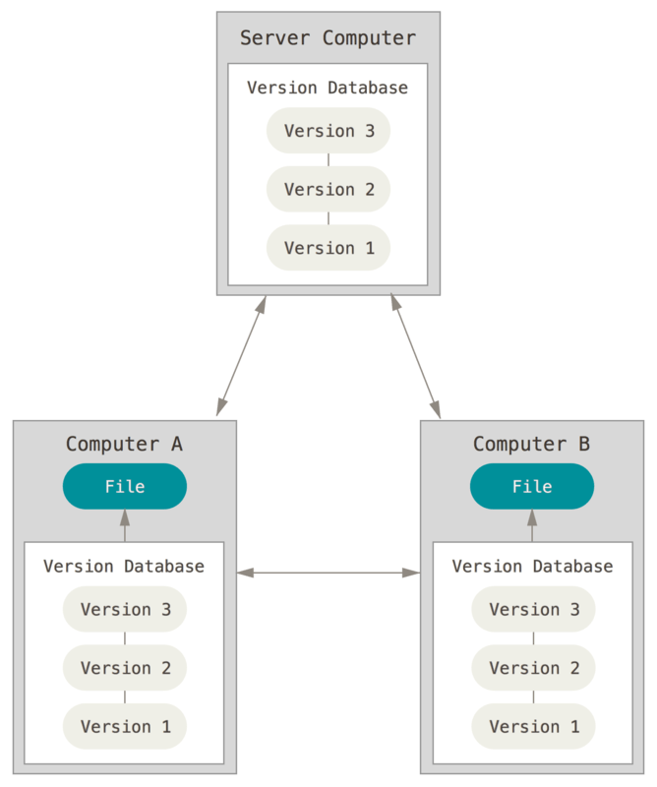
Types of version control
Centralized Version Control
Distributed Version Control
Local Version Control
Notes:
- Git is a type of distributed version control

Slide 5
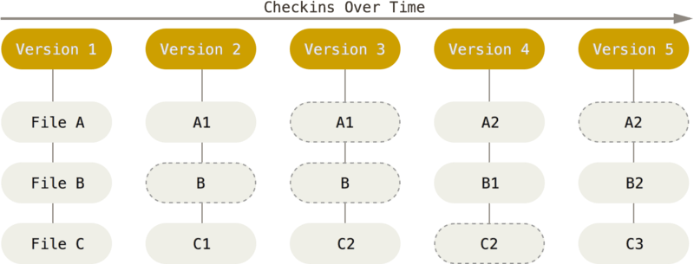
How does git Work?
How does Git save its data?
Stores the data as a stream of snapshots.
Every commit, or version of the project, is saved as a whole snapshot of the project directory.
For efficiency, files that did not change are simply stored as a link to the previous identical file.
Keeps almost all operations local on your PC (except for push and pull).
Everything in Git is check-summed, meaning it is impossible to change a file without Git knowing about it.

Slide 6
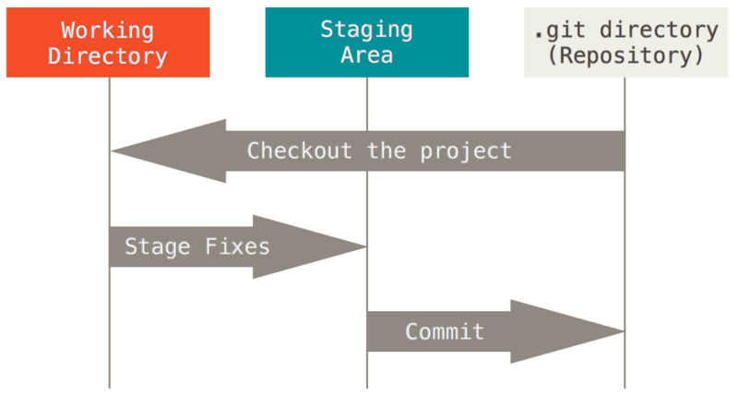
Three states of files
Committed, Modified, Staged
Committed means that the data is safely stored in your local database/repository.
Modified means that you have changed the file but have not committed it to your database yet.
Staged means you have marked a changed file to be included in your next commit.
Repository, Working tree, Staging Area
The repository is where Git stores the metadata and object database for your project.
The working tree is a checkout of a specific snapshot of the project. It is the files you see in your main directory and can edit.
The staging area is a file that stores information about what will go into the next commit.

Slide 7
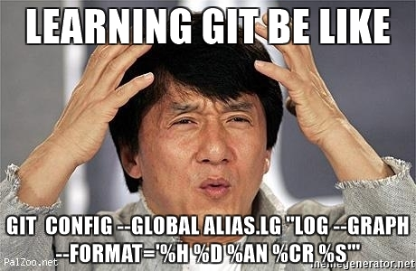

Slide 8
Initial configuration
Things to set up globally or for a specific repository
Identity
Set your name and email to sign commits with. This can be done globally using the --global modifier, or separately for a repository if you omit the modifier
git config --global user.name “John Doe”
git config --global user.email johndoe@example.com
Editor
Git uses your environment’s default editor, which is a variant of vim installed with git. You can change this to any text editor you would like to use, just specify the path to its executable. For simplicity we will use notepad.
git config --global core.editor notepad
Checking all your settings:
This command will show you a list of all the settings it has saved. If you have multiple values, it shows you the one it sees last.
Git config --list
You can also make custom commands using the git alias command.

Slide 9
Getting a repository
Git it going…
Initializing a new repository in an existing project directory
Open Powershell/Command Prompt/Bash/Whatever in the project folder
git init
git add .
git commit –m “Initial Project Setup”
This creates a .git folder in your directory, stages all the existing files and finally does an initial commit containing these staged files.
Cloning an existing repo from somewhere
git clone <url to git repo> <directory to create locally>
This will create a folder and download the git repository to your local system, creating a local repository.

Slide 10
…
Notes:
Do email and name configuration
Initialize a fresh repository in GitClassExamples
Clone https://github.com/rtyley/small-test-repo

Slide 11
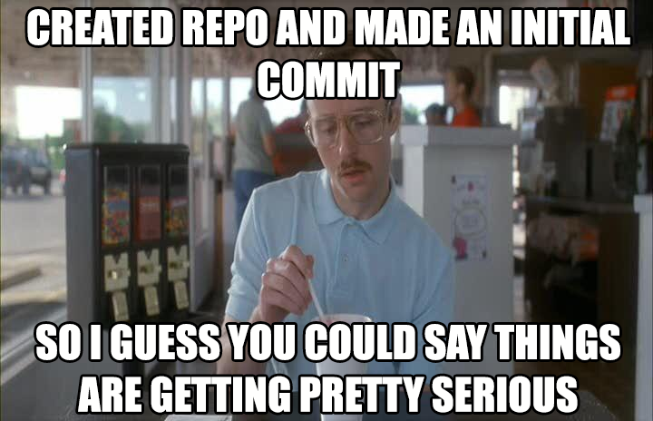

Slide 12
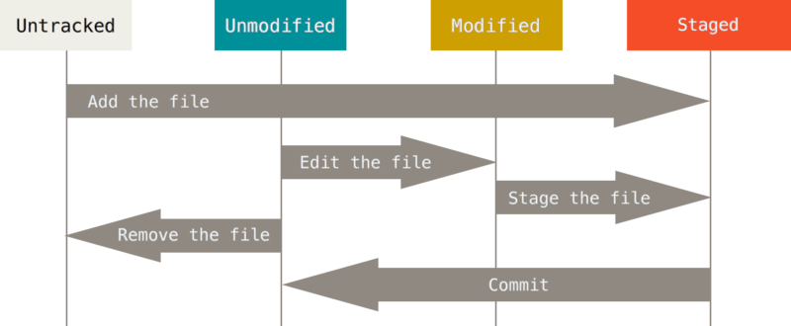
Git File Lifecycle
Notes:
Explain lifecycle process:
When you add new files, they go from being Untracked to being Staged
A commit then adds these files to the repository, they become marked Unmodified
The moment you make any kind of change to the file, git knows this and the file is seen as modified.
Once you are done with your changes, you stage the file with git add <filename>
A commit once again saves the file to the repository and it becomes unmodified again.
Git rm <filename> removes the file from the repository

Slide 13
Let’s talk about gitignore
A proper .gitignore file will save you a lot of headaches in the future
Usually, there are certain files inside of a project directory that you do not want to be included.
These are usually the auto-generated files like the binaries when you build your project, folders containing external dependencies (like node modules or nuget), log files or anything else that you don’t actually need to work on your project.
These kinds of files are unnecessary to keep in source control, and if there, they make merging more difficult and bloat the size of your git repository.
To achieve this goal, we create a .gitignore file.
The .gitignore file contains patterns which git uses to know which files should be ignored.
Gitignores apply recursively to any subdirectories, but you can also have separate gitignore files for separate subdirectories.
You could make your own gitignore file for whichever IDE/Language you are using and probably miss something, or you could thank the nice people at GitHub for doing it for you:
https://github.com/github/gitignore maintains a list of gitignore templates for various languages and IDEs. In most cases these will satisfy your needs perfectly.
Just get the one you need, make a .gitignore file in your working directory and paste the contents into it.

Slide 14
Gitignore Continued
How to make it and what it looks like…
How to create the file
In git bash, do this command: touch .gitignore
Common patterns
Excluding all files with a certain extension:
*.exe
*.bin
*.dll
Etc..
Excluding all files in a certain folder:
foldername/

Slide 15
…
Notes:
- Make a quick gitignore to ignore exes

Slide 16
Saving changes to the repository
You’ll be doing this stuff a lot
git status
This command shows you the current status of your files.
“nothing to commit, working directory clean”: This means that all of your tracked files are unmodified and there are no untracked files.
If you do have changes or added new files, they will show up when you run git status.
git add <file or directory name>
This starts tracking a new file and immediately stages it. If it is an existing file, it stages all of the changes in the file.
You can run git add . to stage and track all of the changes and new files in the directory.
git commit
This will save the files and changes in your staging area as a new snapshot in the repository.
You will be prompted for a commit message using the text editor you specified earlier.
If you wish to avoid the editor, you can supply a commit message inline by adding –m. For example: git commit -m “Added some new text”

Slide 17
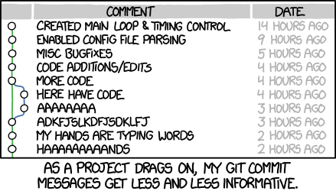

Slide 18
GIT DIFF
Because sometimes git status just doesn’t give enough information
git diff
Compares the working directory to your last commit.
This shows you all the unstaged changes since your last commit.
git diff --staged
Compares the staging area to your last commit.
This will show you all of the staged changes since your last commit.
git difftool
This does the same job as git diff, but opens the result in a difftool, which is a 3rd party piece of software used to visualize git diff output.
The software used can be set with “git config –global diff.tool <difftool name>”
“git difftool --tool-help” will give you a list of available difftools on your system.

Slide 19
GIT LOG
History time…
git log
Shows you the commit history of your repository in reverse chronological order
You can add a dash with a number to limit the amount of commits shown, for example “git log -5” will only show you the last 5 commits.
git log -p
This will show you the commit log, and include the changes that were introduced in each commit (each result will look like the output from git diff)

Slide 20
Fixing the mess you made
Undoing Things
git commit --amend
This commit allows you to redo your previous commit.
Make your changes, stage them, and then run the command. It will add these newly staged changes to the commit and prompt you to update the commit message.
This is good for small changes to your previous commit, like forgetting to add a file or something like that.
git reset HEAD <filename>
This command unstages the staged file that you specify in the command.
Your changes are kept, the file is just removed from the staging area, but remains untouched in the working directory.
git checkout -- <filename>
This command replaces a file you changed with the committed version of the file from your previous commit, thereby undoing any changes you have made since that commit.
Be careful: You will lose those changes and not be able to recover them.

Slide 21
…
Notes:
Do a git add
Show git status
Git commit
Show git status
Git log

Slide 22
Git Remotes
The distributed part of distributed version control
Remote repositories are what allow you to share and collaborate with other people.
A remote repository is a version of your project repository that is hosted somewhere on the internet or on your network. You could even have a remote repository on the same local machine if you needed that.
In general, you will have either read-only or read/write permissions to a certain remote repository.
You pull data from the remote if you need the latest version of your project, and you push data to the remote to share your changes with everyone on the project.
git remote
This command will output a list of remotes that are linked to the repository you are working on.
If you’ve cloned your project from somewhere, it will contain a remote named “origin”, this is the default remote and refers to the server that you cloned the project from.
git remote -v
This will show you the list of remotes and include the URLs it has for them in case you need more information.

Slide 23
Adding git remotes
To explicitly add remotes other than origin
git remote add <shortname> <url>
This command is used to add a new remote to your project.
shortname can be any name you wish to use to refer to this remote with.
URL is the URL of the remote repository that you want to link to.
Example: git remote add helloremote https://github.com/paulboone/ticgit
git remote rename <original shortname> <new shortname>
This is used to change the shortname of an existing remote.
git remote remove <shortname>
This one removes an existing remote from your repository.
All remote tracking branches and configuration settings related to that remote will be removed as well.

Slide 24
Fetch, Pull and Push git remotes
Push it real good
git fetch <remote>
This command checks the remote and pulls down any data that you do not have yet locally.
It stores the references to the branches in the remote, but does not yet merge the data into your own repository. From here you can manually merge them in.
If your current branch has a remote tracking branch, you do not have to specify the remote, it will use the remote tracking one by default
git pull
This command fetches the data and attempts to automatically merge it into your current branch. Unless you’ve changed the setting, it will usually pull from origin.
If there are merge conflicts you will have to solve those first before the merge can complete.
git push <remote> <branch>
This will push any commits you have made since your last push to the remote server, sharing it with everyone on the project.
This will NOT work if there are commits on the remote that you do not yet have locally, so try to always run a pull before you push, to make sure you are up to date.

Slide 25


Slide 26
…
Notes:
Make a git remote
Add one
Do a pull, push

Slide 27
Git Aliases
Just a small feature, but probably worth knowing
Remembering all of these commands can be quite tiresome, and some of them are quite long to type out.
Git Aliases help you get around this by allowing you to specify an alias for any command in git. You can use this to make easier to remember commands, shorten the really long ones.
git config --global alias.<alias name> ‘ <command> ’
Example: git config --global alias.pushitrealgood ‘push origin master --force’
This example makes it so you can use the command “git pushitrealgood” to do a force push to the master branch of origin. (You probably really shouldn’t be using that command)

Slide 28
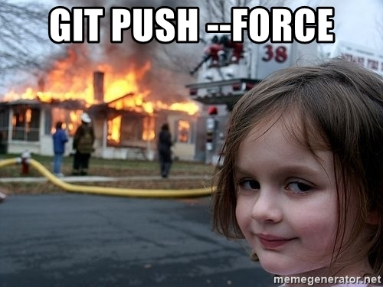

Slide 29
Git STASH
Just stash the stuff somewhere!
Sometimes you’ll have changes in your working directory that you do not want to commit yet, but you want to switch to a different branch, work on something new that requires a clean working directory or need to pull changes in without merging.
git stash – This will clean out your working directory, reverting back to the previous commit. The changes are added to the stash, which can be a stack of various sets of changes.
git stash list – This will show you a list of all the stashes on the stack.
git stash pop – When you are ready to add the changes back into your working directory, this command will apply them onto the working directory and then immediately drop them from the stack.
git stash apply – Does the same thing as pop, but keeps the stash on the stack.
git stash branch <stash name> - Use this to make a branch from a stash.

Slide 30
…
Notes:
- Quickly show how git stash works

Slide 31
BRANCHING, Merging And Rebasing

Slide 32
Branching
The Killer App
When you make a commit, and object is created that contains a pointer to the snapshot of the content you committed.
The pointer to the commit you are currently working on is called HEAD.
Each branch also has a separate pointer, and the HEAD pointer points to one of those branch pointers.
The default branch on any project is called master.
When you create a new branch, a new pointer is made that points to the current commit.
When you switch between branches, the HEAD pointer is moved to the pointer of the other branch.
Any commits on this branch will diverge the branch from the master branch’s history.

Slide 33
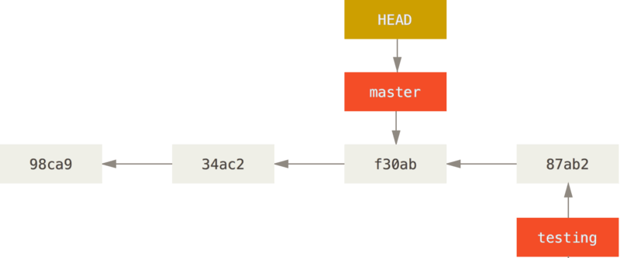
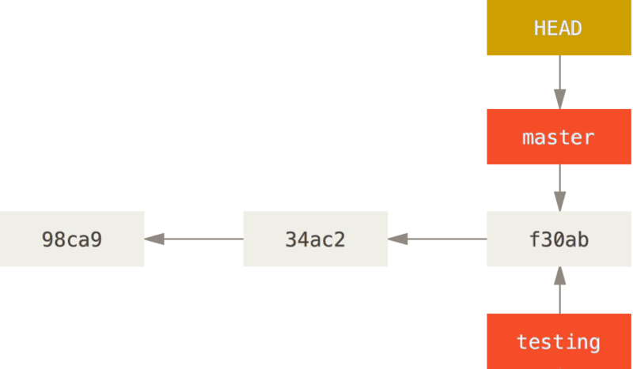
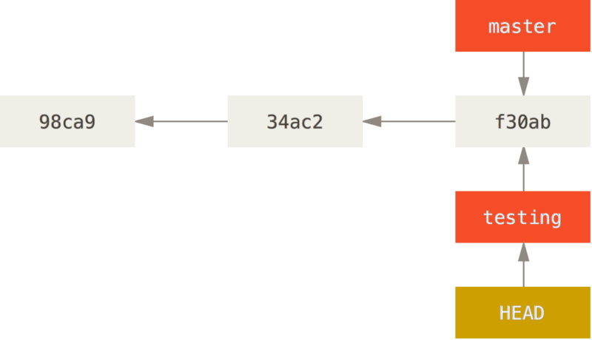
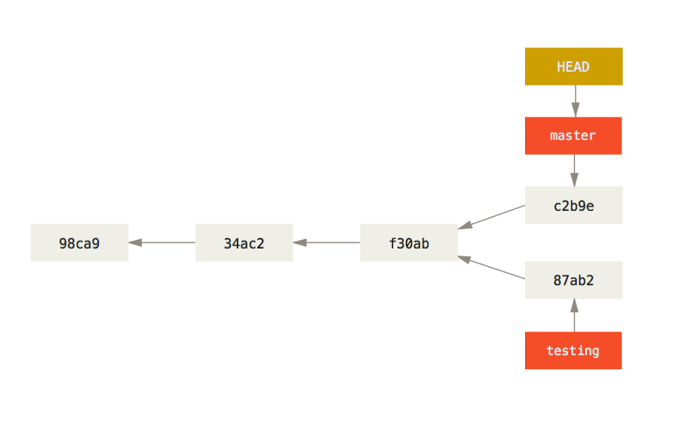
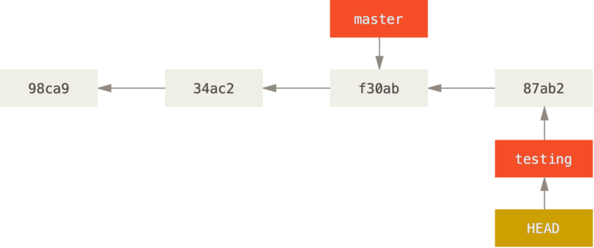
Notepad test.text
git commit –a –m “made a change”
Notepad test.text
git commit –a –m “made other change”
Git checkout master
git branch testing
git checkout testing

Slide 34
…
Notes:
- Make the branch in git as seen on previous slide

Slide 35


Slide 36
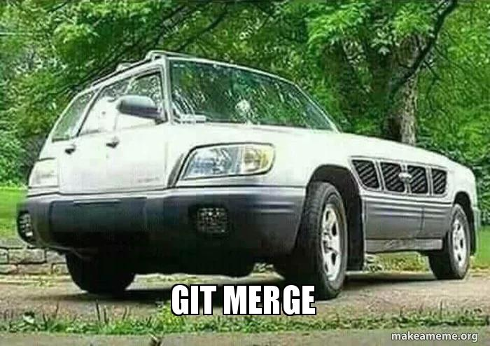

Slide 37
Git Merge
Try to put everything together…
When you pull from a remote repository, or you have two branches that need to become one, you will make use of git merge.
Git does a three way merge between the latest commit on the main branch, the branch you are merging in and their most common ancestor.
Sometimes git will be able to figure out what is going on and automatically merge the files. Most of the time, though, there will be conflicts to resolve, especially if two branches handled the same file.
When you do a pull, the merge is initiated automatically. If you are merging to local branches, there are some steps to follow
Steps: Checkout the branch you want to merge another branch into. In this case, we’ll be merging testing into master. Then do the merge.
checkout master
git merge testing
Once the merge is complete, git creates a new commit with the results of the merge.

Slide 38
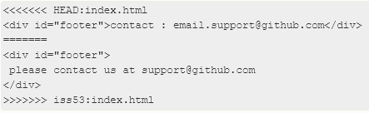
Merge Conflicts
…then realize you cannot.
Suddenly you see the dreaded message. “Automatic merge failed, fix conflicts then commit the result”. Checking git status will reveal to you which files have conflicts to resolve.
Go to your working directory and open those files. They will have a section that looks something like this:
Everything above the “=======“ line is the content of HEAD.
Everything below is the content from the branch you are merging in.
To resolve the conflict, pick whatever you need from each section, delete the rest, make sure to also delete the <<<<<<<HEAD line, ======= line, and the >>>>>>>branchname line.
Stage the now merged files and commit them to finalize the merge.

Slide 39
…
Notes:
Merge the branches and resolve the git conflict

Slide 40
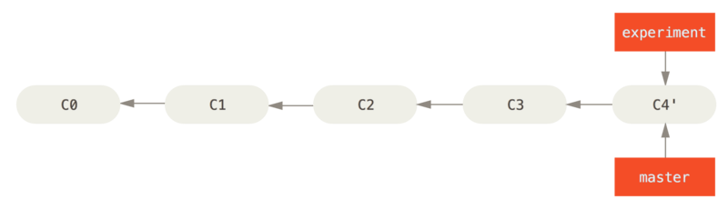
REBASING
Like merging, only completely different
Another way of combining to diverged branches.
Instead of doing a 3-way merge, combining the endpoints of both branches, a rebase takes the changes from one branch and replays them on top of another branch.
git rebase testing
This is the basic rebase, it just takes the commits from the testing branch and replays them on top of master.
git rebase <branch to rebase>

Slide 41
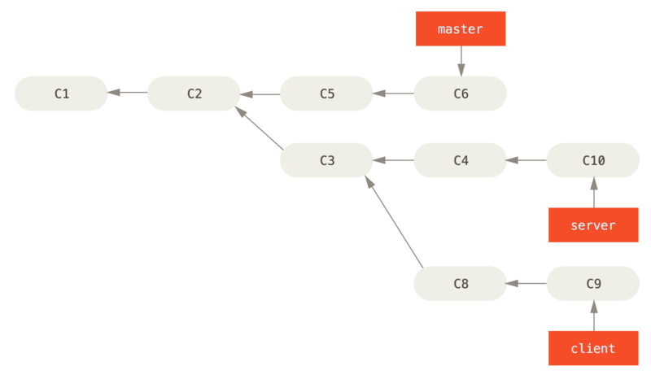
REBASE --ONTO
More interesting rebases
Suppose you have a history like the one on the right
You want to merge the changes from the client branch
You do NOT yet want to merge the changes from the server branch.
git rebase --onto master server client
This takes all the changes from client, since it diverged from client,
and rebases them onto the master branch as if they were based directly
on the master branch.
git rebase --onto <target branch> <diff branch> <branch to rebase>

Slide 42
…
Notes:
Do the same thing as previously but with a rebase

Slide 43
DO NOT REBASE PUSHED COMMITS DON’T DO IT JUST DON’t

Slide 44
Interactive REBASE
Rewriting history
git rebase -i HEAD~<amount of commits you want to go back>
Your editor will open up with a list of commits and instructions
For commits you want to change, change the word “pick” in that line to one of the following:
“edit” – this will stop the rebase after that commit, allowing you to amend the commit.
“reword” – this will take the commit but let you edit the commit message.
“squash” – this will pick this commit, but combine it with the previous commit as one commit.
“fixup” – this does the same thing as squash, but discards this commit’s commit message.
You can also reorder the entries in this list of commits, this will cause them to rebased in this new order.
Removing a commit from this list discards that commit and the changes connected to it completely.
Whenever you are done editing a commit, do “git rebase --continue“ to let the process go on.

Slide 45
…
Notes:
Show an interactive rebase

Slide 46
GIT GUI
Do it pretty
The git command line is very powerful and it is important that you know how everything works, in case you need to fix something.
That being said, for day-to-day work you might prefer to use a GUI, of which there are quite a few:
GitExtensions – Not very pretty but quite powerful and has a lot of features
GitKraken – Very well designed GUI, but can be slow and is less powerful than GitExtensions
Visual Studio Team Explorer – This has support for git and is nice to quickly do some git things while working on a project inside of visual studio.
Many other IDEs also have built in git integration. These are usually not extremely feature-rich, but are perfectly acceptable for just committing, pulling and pushing code.

Slide 47
GIT Hosting
Great repository hosting is everywhere
It isn’t always practical to host your own git remote server.
Luckily, there are A LOT of online services that provide you with git hosting:
GitHub – This is the most popular one, recently acquired by Microsoft. Free for public repositories, if you want private repositories it will cost $7 a month.
GitLab – This is the one everyone ran to when Microsoft acquired GitHub. Unlimited private repositories for free. Unlimited amount of users on a team.
BitBucket – Owned by Atlassian. Free private repositories for a maximum of 5 users on a team.

Slide 48
Exercises
Practice what you have learned
https://gitexercises.fracz.com/
Open PowerShell and follow the instructions in “How to start” at the provided link. You can even just copy and paste the commands listed there.
Enter the email you provided on the site to track your progress.
Work through the exercises as they are provided and see how far you get.
If you need some help, use the documentation at https://git-scm.com/book/en/v2/ to find what you need.

